Slide 1
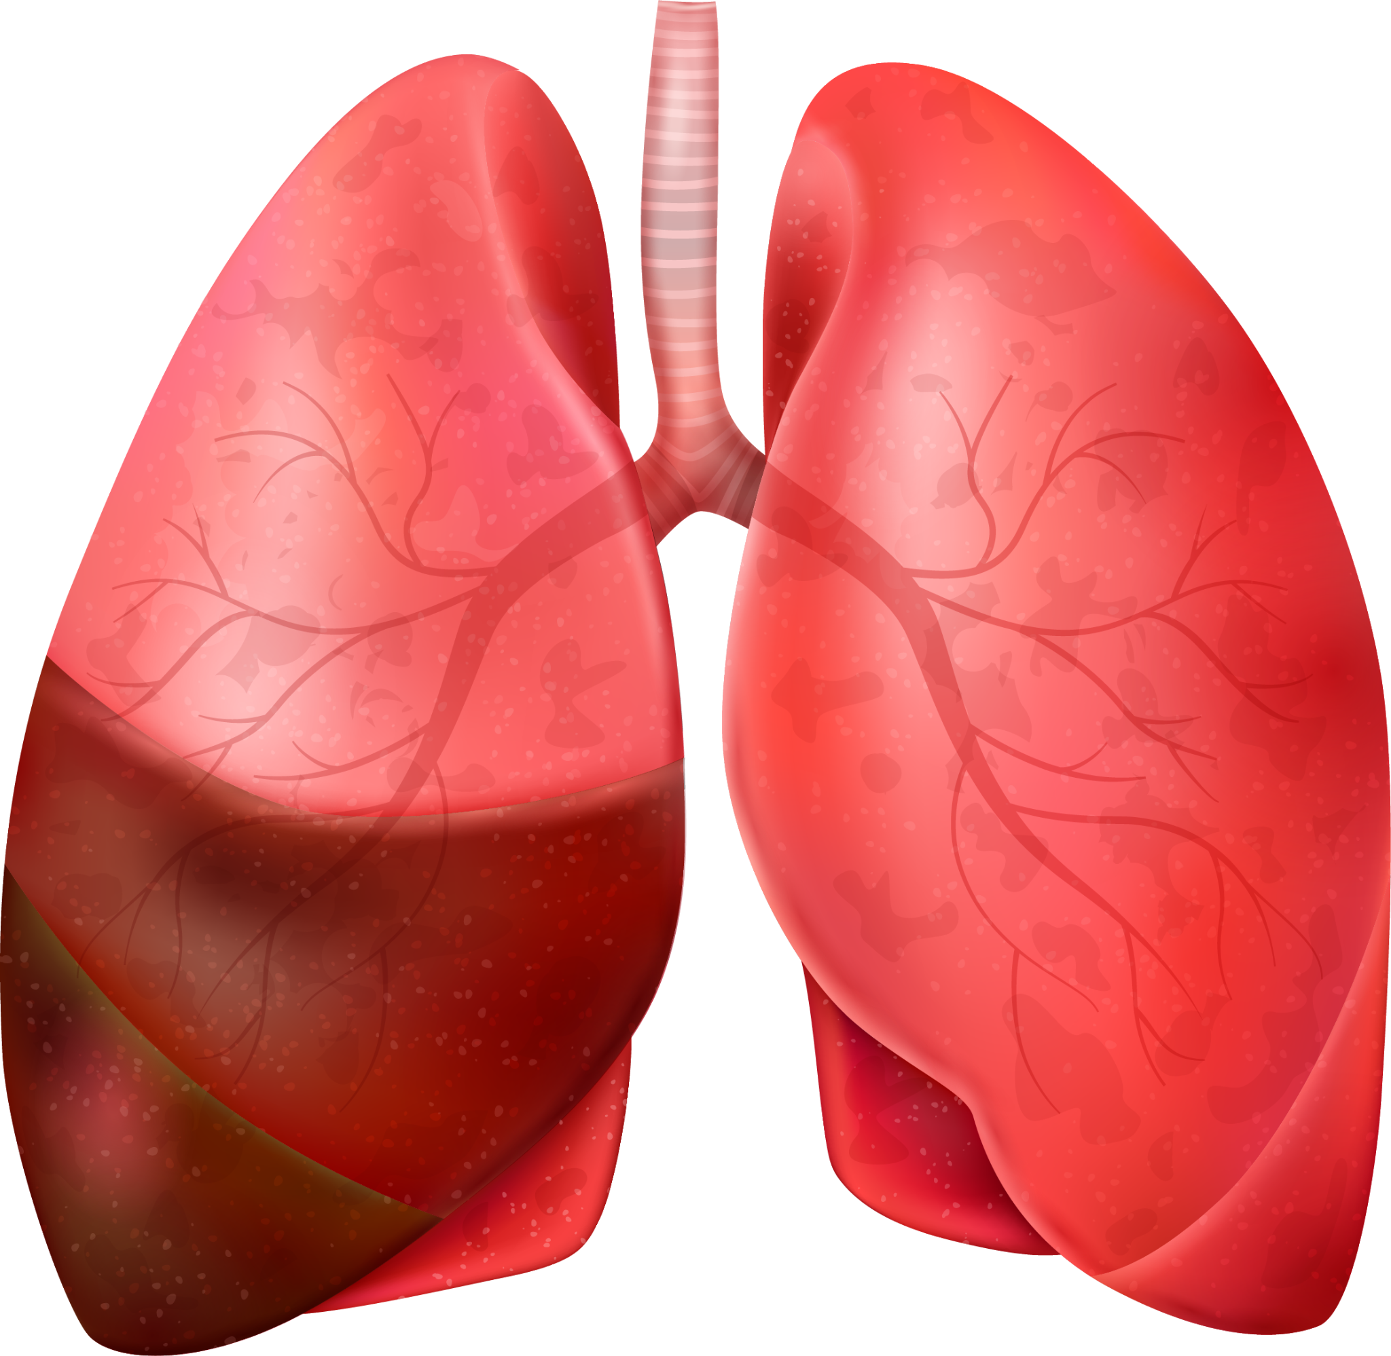
IMAGE CLASSIFICATION OF X-RAY IMAGES FOR PNEUMONIA DETECTION

Slide 2
PHASE 4 GROUP 5 MEMBERS
Lisa Mwikali
Nicole Bosibori
Ivan Wawire
Anne Njoroge
Maureen Muriithi
Charles Egambi

Slide 3
INTRODUCTION
Pneumonia is a common and potentially fatal lung infection. Accurate diagnosis is essential for effective treatment and patient management. The "Large Dataset of Labeled Optical Coherence Tomography (OCT) and Chest X-Ray Images" is a comprehensive collection of medical images, aiming to support advancements in medical diagnosis through deep learning.

Slide 4
Business problem
In healthcare, accurate and efficient disease diagnosis is vital. Traditional methods of diagnosing pneumonia involve lengthy exams and lab tests, often requiring multiple doctor visits. This project aims to streamline this process using a deep learning model to detect pneumonia from chest x-ray images, providing faster and more precise diagnoses.

Slide 5
objectives
Main Objective
To develop a deep learning model to classify chest x-ray images for pneumonia detection.
Specific Objectives
To determine the most effective architecture for pneumonia detection.
To train the deep learning model.
Assess the trained model’s performance to validate its effectiveness in detecting pneumonia.

Slide 6
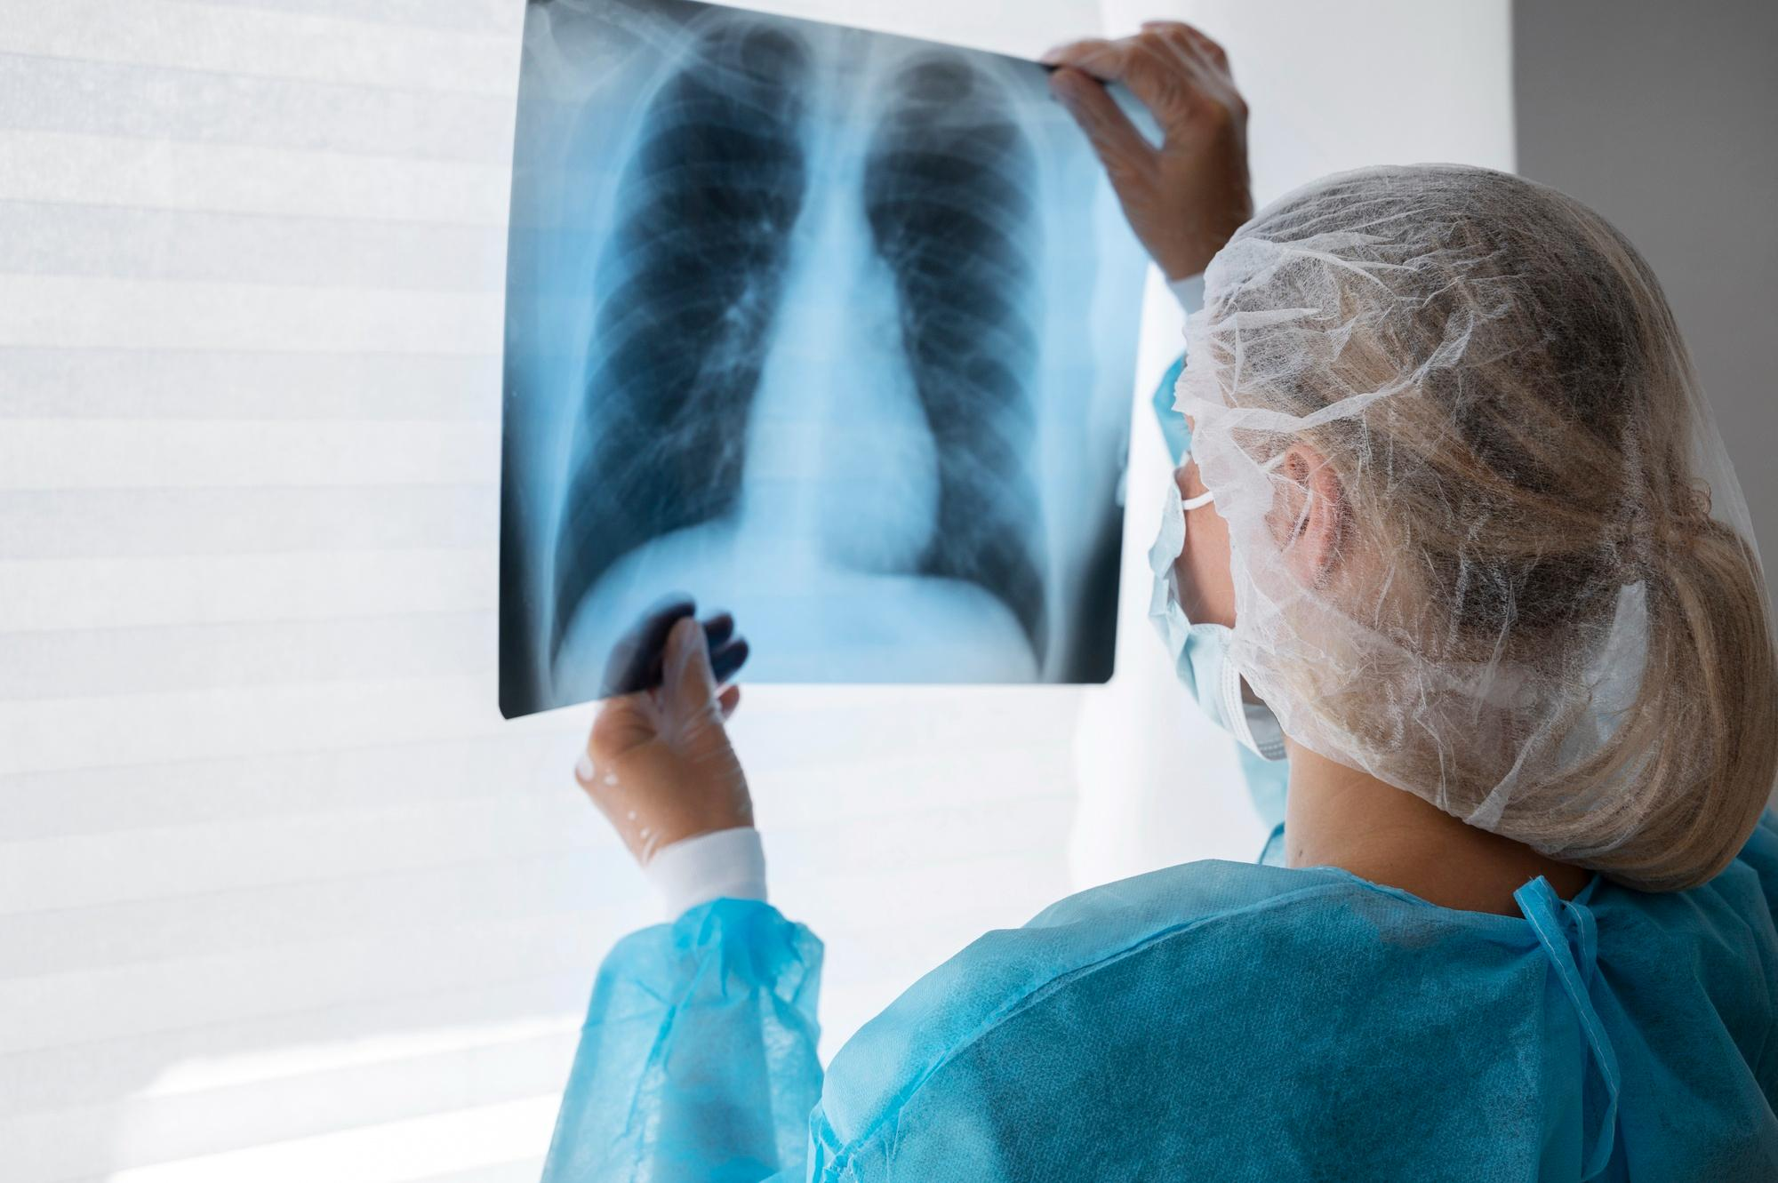
STAKEHOLDERS
Health Professionals
Patients
Radiologists
Medical Researchers

Slide 7
DATA OVERVIEW
Source: Mendley Data
Data Organization: The images are categorized into “train”, “test” and “val” folders
Categories: The images can be classified into two ; “Pneumonia” and “Normal”
Patient Demographics: Ages 1-5years, Guangzhou Women and Children’s Medical Center
Image Details: Anterior – posterior chest X-rays, part of routine care

Slide 8
Metric of success
The performance of the models will be evaluated using the following metrics:
Loss: This metric measures the error between the predicted values and the actual values. Lower loss indicates a better fitting model. We will use the test loss to evaluate the model's ability to generalize to new data.
Accuracy: This metric indicates the proportion of correctly classified instances out of the total instances. Higher accuracy indicates better model performance in terms of classification correctness.

Slide 9
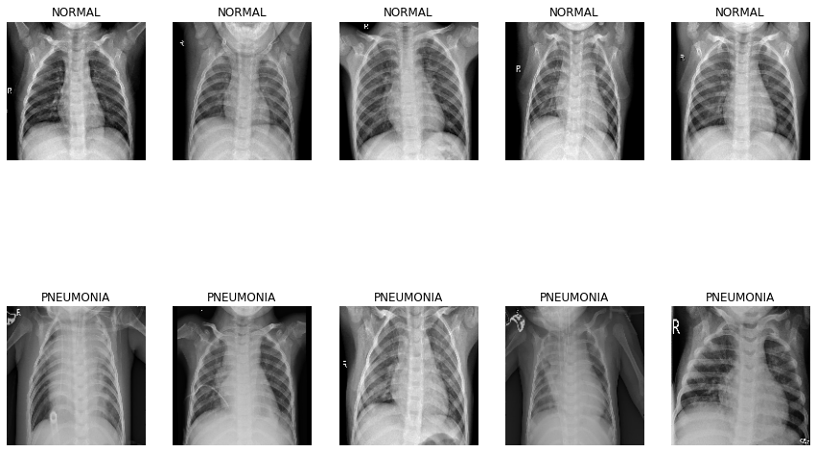
SAMPLE IMAGES TO DISTINGUISH BETWEEN NORMAL & PNEUMONIA CASES

Slide 10
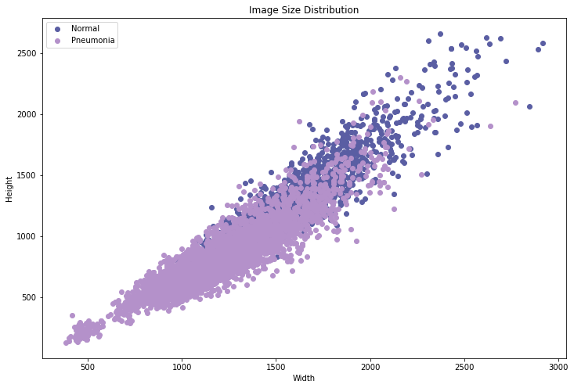
SCATTER PLOT DISPLAYING Image Size Distribution
Shows the variation in dimensions of the x-ray images, which was important for preprocessing steps

Slide 11
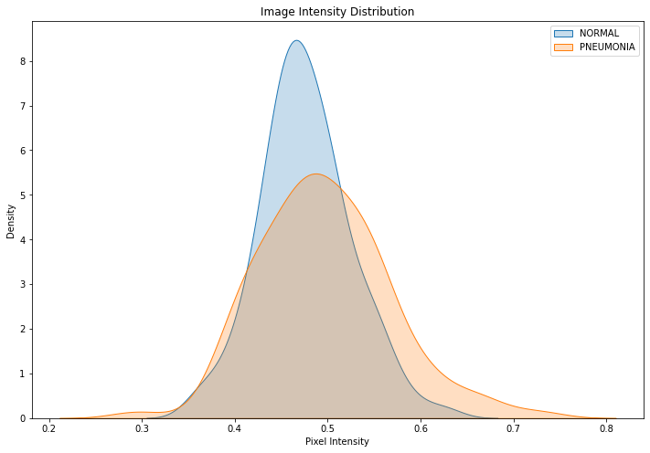
IMAGE INTENSITY DISTRIBUTION
Normal and pneumonia images have similar peak pixel intensities with significant overlap, but pneumonia images exhibit a broader distribution, indicating greater variability in pixel values possibly due to varying degrees of infection or different visual characteristics of the disease.

Slide 12
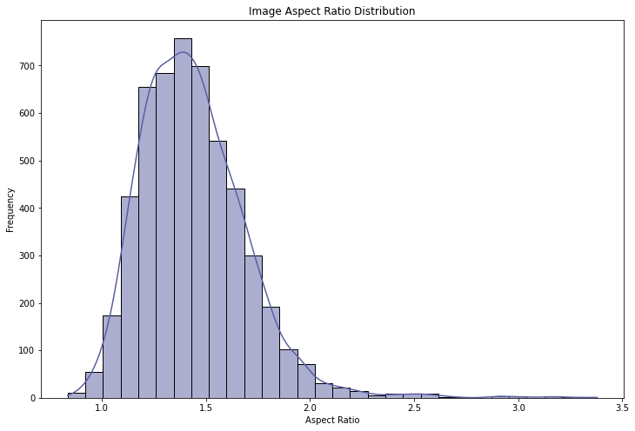
HISTOGRAM SHOWING IMAGE ASPECT RATIO DISTRIBUTION
Shows the shape and proportion of the images.
The aspect ratio distribution indicates that most images have an aspect ratio between 1.0 and 1.5, with a peak around 1.3.

Slide 13
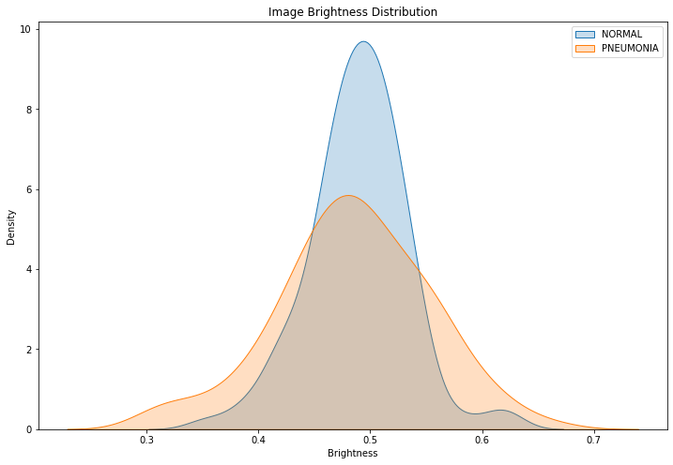
IMAGE BRIGHTNESS DISTRIBUTION
Normal and pneumonia images have overlapping brightness distributions, with pneumonia images showing a wider spread and a lower peak brightness, indicating that normal images are generally brighter on average.

Slide 14
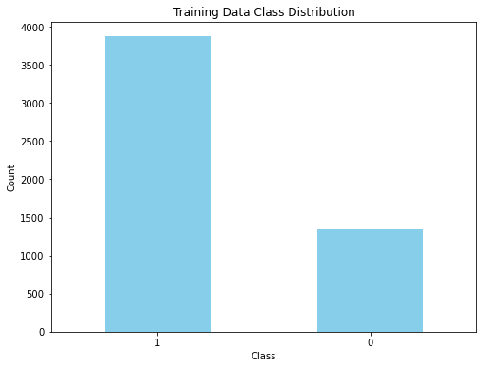
BAR GRAPH DISPLAYING TRAINING DATA CLASS DISTRIBUTION
Show the number of images in the dataset for normal(0) vs pneumonia(1), with pneumonia being the highest

Slide 15
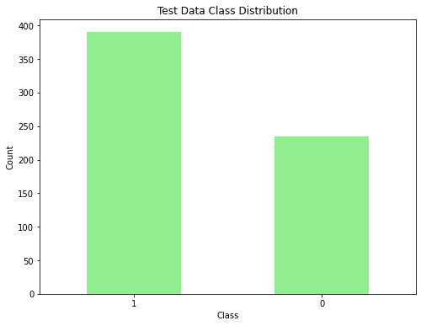
BAR GRAPH DISPLAYING TEST DATA CLASS DISTRIBUTION
Show the number of images in the dataset for normal(0) vs pneumonia(1), with pneumonia being the highest

Slide 16
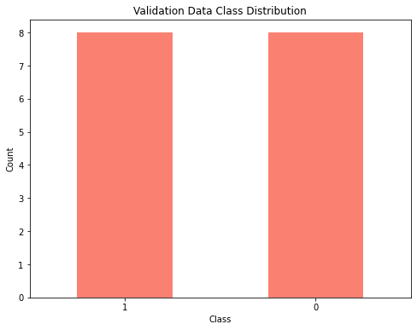
BAR GRAPH DISPLAYING VALIDATION DATA CLASS DISTRIBUTION
Show the number of images in the dataset for normal(0) vs pneumonia(1), with pneumonia and normal being equal

Slide 17
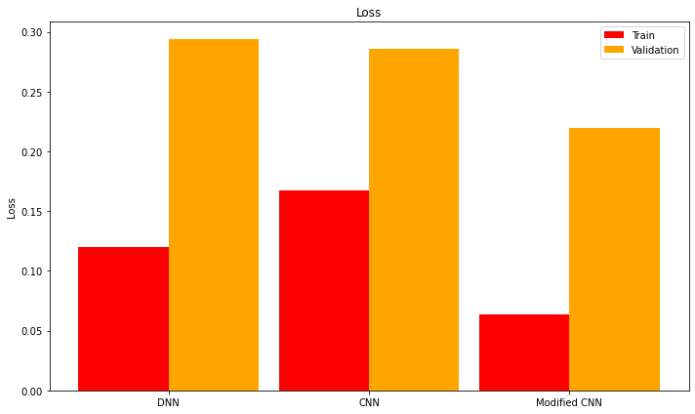
Model evaluation
The bar chart compares the performance of the models across training and validation metrics, showing that the Modified CNN model performed better since it had the least loss.

Slide 18
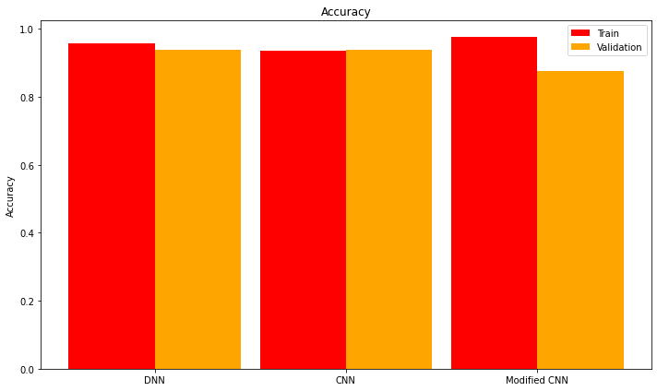
Model evaluation
The bar chart compares the performance of the models across training and validation metrics, showing that the Modified CNN model performed better since it had the best accuracy levels.

Slide 19
RECOMMENDATIONS
Regularization: Prevent overfitting and enhance generalization.
Hyperparameter Tuning: Optimize model configurations for peak performance.
Ensemble Methods: Combine diverse models for improved accuracy and robustness.
Cross-Validation: Rigorously assess model performance across multiple data splits.
Data Augmentation: Expose models to diverse data to improve real-world capabilities.

Slide 20
NEXT STEPS
Severity Assessment: Beyond identifying pneumonia's presence, the AI model can determine its severity (mild, moderate, severe), providing clinicians with crucial information for treatment decisions.
Pneumonia Type Identification: Differentiating between bacterial and viral pneumonia can guide appropriate treatment plans, as antibiotics are only effective for bacterial infections.
Precise Localization: The model can pinpoint the specific lung areas affected by pneumonia, aiding further investigation and targeted treatment.
Cloud Accessibility: Deploying the model on a cloud platform ensures widespread access for hospitals and clinics, facilitating broader utilization and impact.

